Slide 1
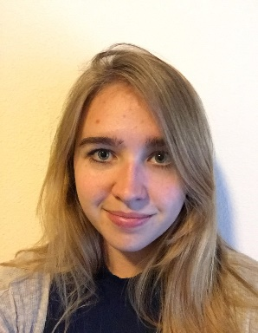
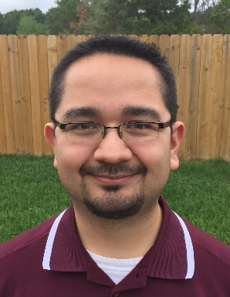
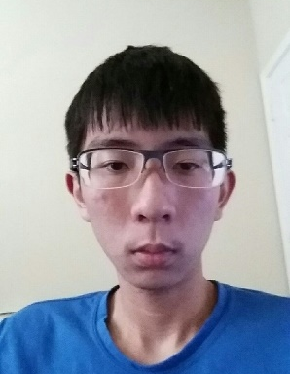

Project Avalanche
Team Booyah
Mario Aguilar Margaret Baxter
Patrick Quach Christine Russell

Slide 2
Introduction
Extend functionality of Project SkiLift
Create an Android GUI
Develop using Android Studio
Make use of SQLite and SPI
Practice using Agile development principles and practices (Scrum)
Practice presenting work to others in a public setting

Slide 3
Technical aspects
Project Avalanche will:
Run on an Android device
Run season simulations
Give predictions based on Power Ranking, Bayes, and Pi Rating prediction algorithms
Get predictions internally through the use of a Service Provider Interface
Uses SQLite as its DBMS
Seek to take advantage of distinct mobile device functionality

Slide 4
Code Snippet
// ApplicationTest.java
package booyah.nflapp;
import android.app.Application;
import android.test.ApplicationTestCase;
/**
* Testing Fundamentals
*/
public class ApplicationTest extends ApplicationTestCase<Application> {
public ApplicationTest() {
super(Application.class); }
}

Slide 5
Code Snippet
// ExampleUnitTest.java
package booyah.nflapp;
import org.junit.Test;
import static org.junit.Assert.*;
/** * To work on unit tests, switch the Test Artifact in the Build Variants view. */
public class ExampleUnitTest {
@Test
public void addition_isCorrect() throws Exception {
assertEquals(4, 2 + 2);
}
}

Slide 6
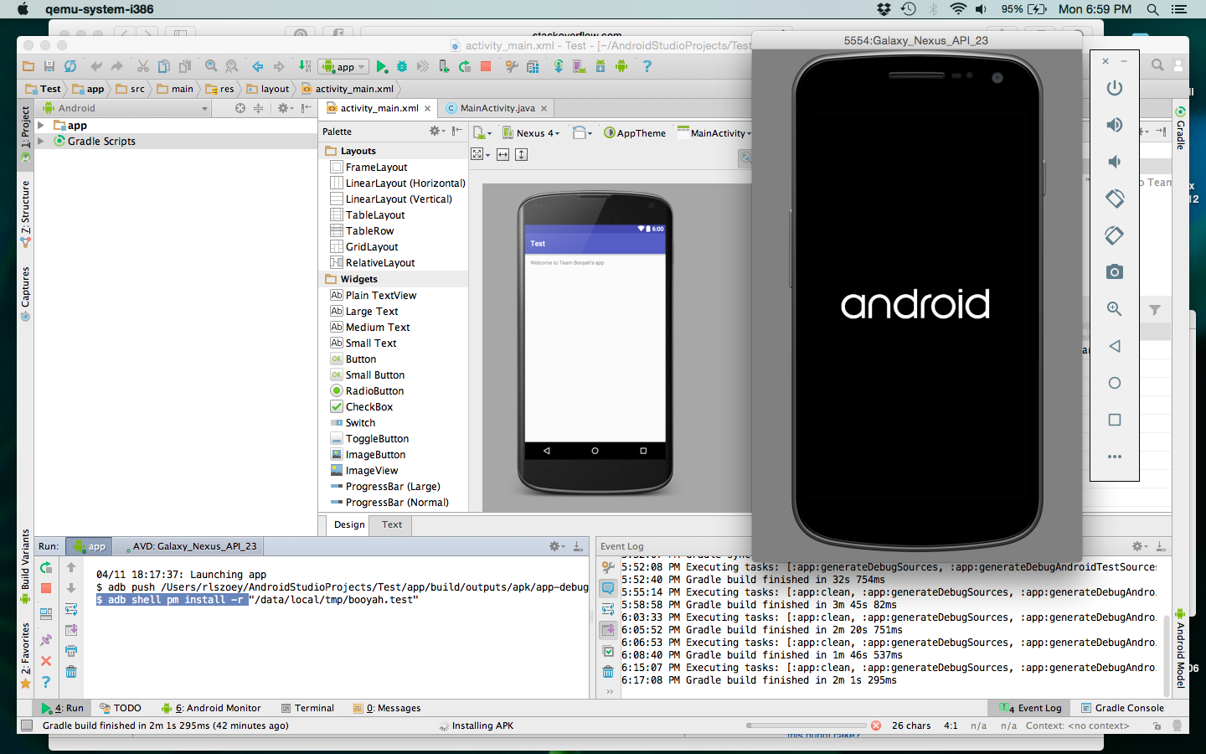
Screenshots

Slide 7
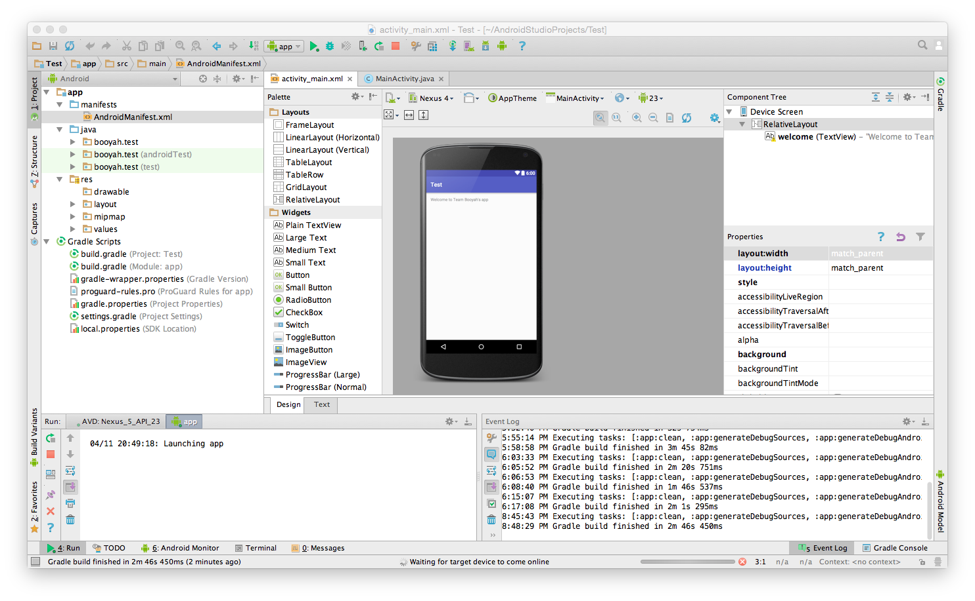
Screenshots

Slide 8
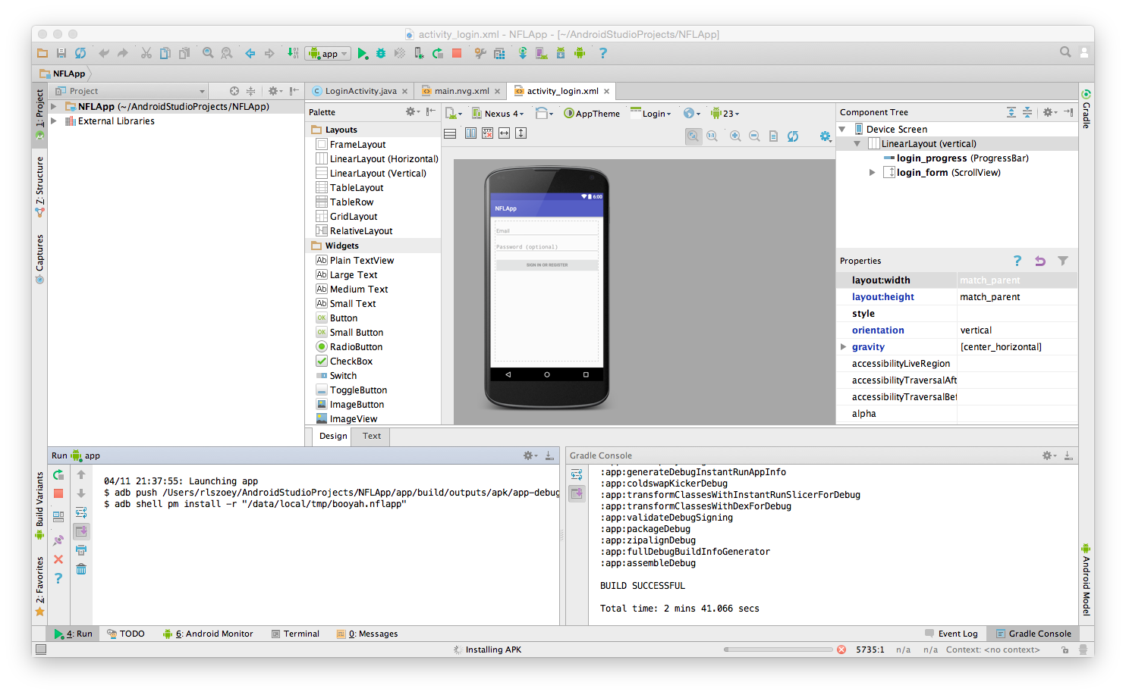
Screenshots

Slide 9
Conclusion
Everyone installed Android Studio and practicing using it.
Started taking notes on Pi Rating algorithm. Just finished planning the implementation and will begin writing code on Saturday.
Compiling simulation data of ways to improve power rank calculation by varying how the initial set of ASM values is calculated, and how much data is used to calculate them.
Had some trouble understanding what Android Studio’s HelloWorld program actually did.
Antivirus seems to get in the way of running the Android simulator.
Had to completely reinstall Android Studio, update Java and Java Virtual Machine.
Created an app with a login screen and one with just “Welcome to Team Booyah’s App”.
Simulated on a Nexus and Galaxy emulator using Marshmallow.
Finished moving data from the old database into a SQLite database format.

